Slide 1

BTS of Generative AI

Slide 2
Recurrent Neural Networks (RNN)

Slide 3
Contents
RNN
LSTM
Introduction
Broad Types of RNNs
RNN Architecture
How does RNN work
RNN in action
Backpropagation through time
Problems with RNN
Introduction
LSTM Architecture
How does LSTM work
Various Gates in LSTM
Variants of LSTMs
Drawbacks
Conclusion

Slide 4
Introduction
Concept of Sequential Memory
Activity:
Think about any sentence you know by-heart (from the lyrics of your favourite song/ nursery rhyme/ anything)
Tell it aloud
Now say the words in the reverse order

Slide 5
Introduction
Concept of Sequential Memory
Examples of Sequential Data:
1. Words are a sequence of letters: D O G S
2. Sentences are a sequence of Words: DOGS ARE VERY LOYAL.
3. Speech/ audio is a sequence of audio chunks
4. Time Series Data

Slide 6
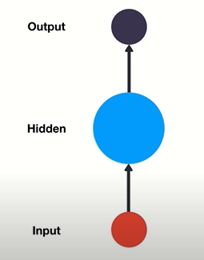
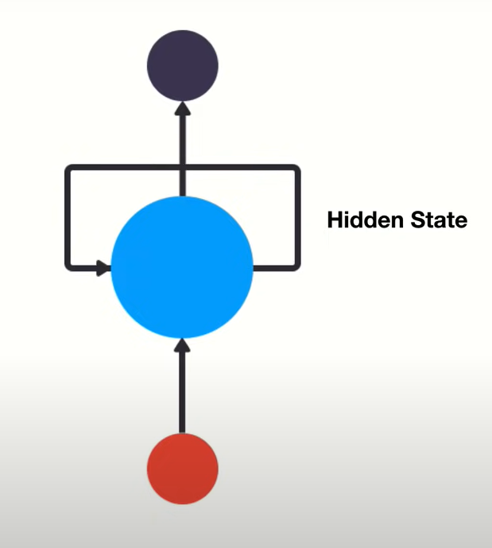
Introduction
Feed Forward Networks:
Recurrent Neural Networks:

Slide 7
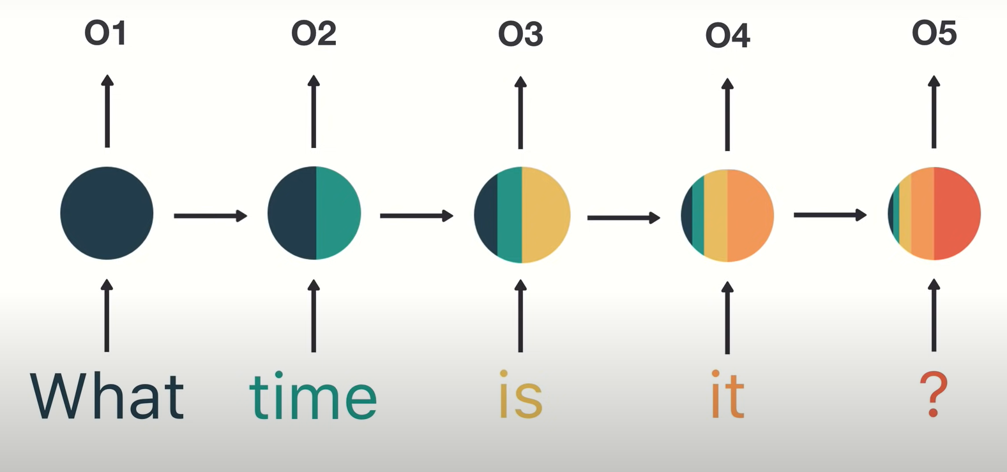
Concept of Internal Memory
RNN has memory capabilities. It memorizes previous data.
While making a decision, it takes into consideration the current input and also what it has learned from the inputs it received previously.
Output from previous step is fed as input to the current step creating a feedback loop.
This kind of memory is short term memory

Slide 8
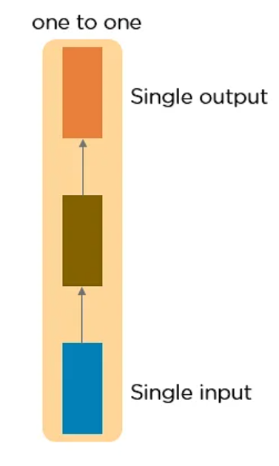
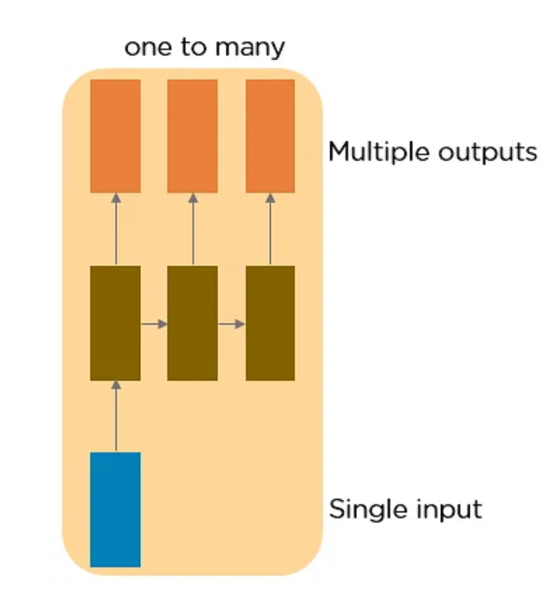
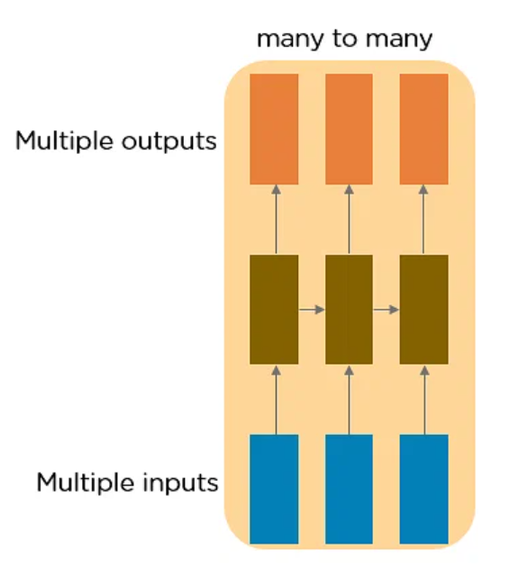
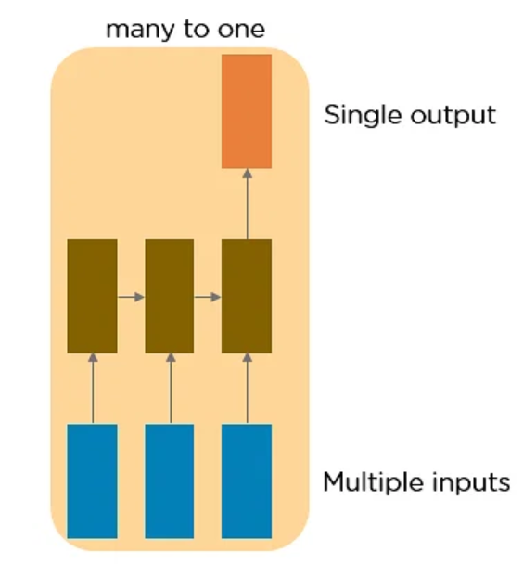
Broad Types of RNNs
One to One (Vanilla) RNN
Eg: Single IP/OP Problems
One to Many RNN
Eg: Image Caption
Many to One RNN
Eg: Sentiment Analysis
Many to Many RNN
Eg: Machine Translation

Slide 9
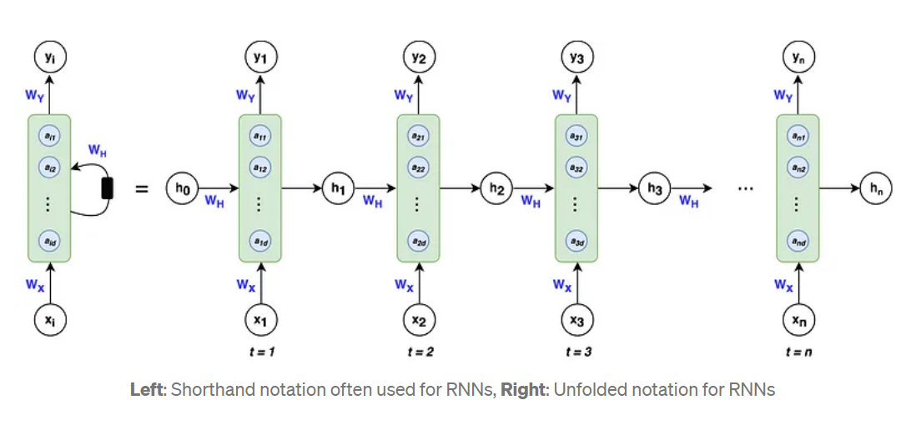
RNN Architecture

Slide 10
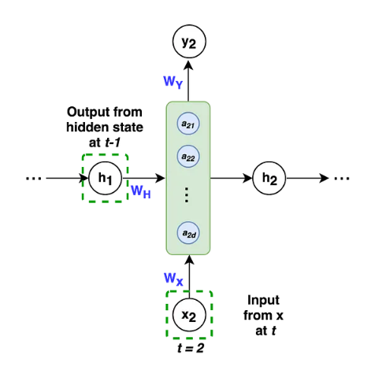
The Repeating Module

Slide 11
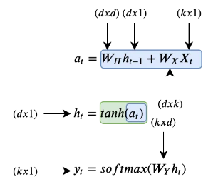
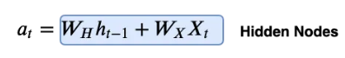
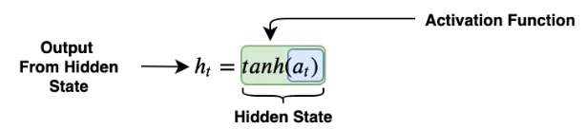
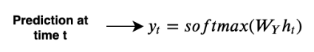
How does RNNs work
Step 1: multiply weights with inputs
Step 2: Apply activation function on output of hidden nodes
Step 3: Predict at time t
k is the dimension of the input vector xᵢ
d is the number of hidden nodes

Slide 12
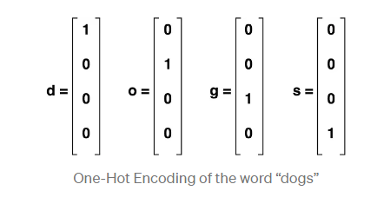
RNNs in action
Using RNN to predict letters in a word:
Consider the word DOG:
RNN has to predict next letter to match the previous sequence, eg D-O-G- S

Slide 13
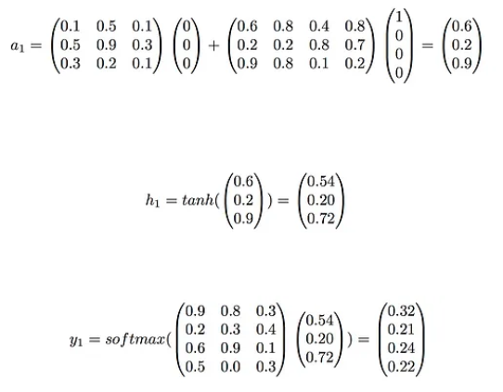
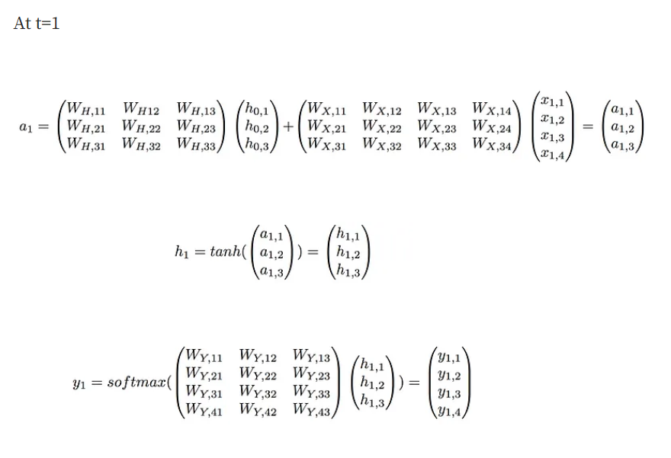
RNNs in action
Forward Propagation
(Weights are randomized)

Slide 14
RNNs in action
At t=1, our RNN would predict the letter “d” given the input “d”. It happened because we’ve used untrained random weights.
At t=2 and t=3, the workflow would be analogous except that the vector h from t-1 would no longer be a vector of 0’s, but a vector of non-zeros based on the inputs before time t.
As a reminder, the weight matrices Wx, Wh, and Wy remain the same for t=1,2, and 3.
It’s important to note that while the RNN can output a prediction at every single time step, it isn’t necessary. If we were just interested in the letter after the input “dog” we could just take the output at t=3 and ignore the others.

Slide 15
Backpropagation Through time
To get a concrete understanding of how backpropagation works, let’s lay out the general workflow:
Initialize weight matrices Wx, Wy, Wh randomly
Forward propagation to compute predictions
Compute the loss
Backpropagation to compute gradients
Update weights based on gradients
Repeat steps 2–5

Slide 16
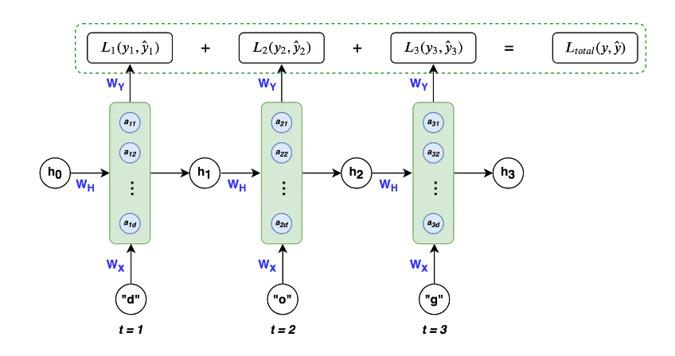
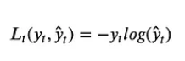
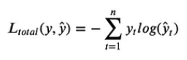
Backpropagation in the example
We will use multi-class cross entropy loss function as the loss function
Adding losses for every time instance, the overall loss is:

Slide 17
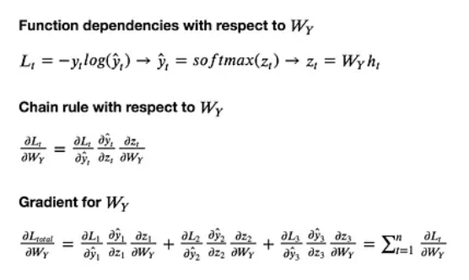
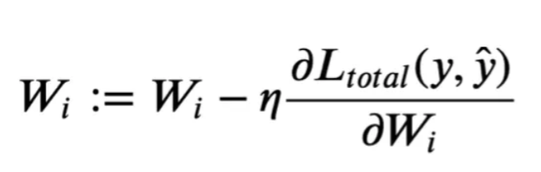
Backpropagation in the example
Weight Updation:
Where Wi is W_{H}, W_{X} and W_{Y}
Challenging part is calculation of the gradients for W_{H}, W_{X} and W_{Y}
For W_{Y} (similarly for W_{H}) :

Slide 18
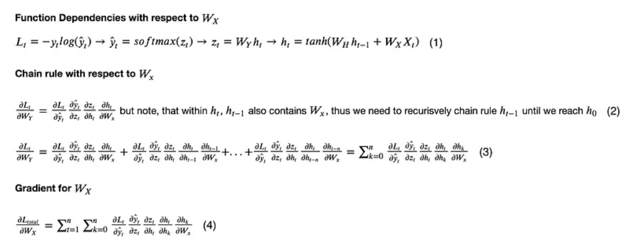
Backpropagation in the example
For W_{X} :

Slide 19
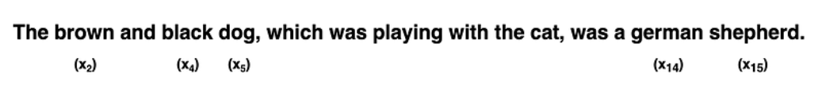
Problems with RNN
Vanishing/Exploding Gradient Problem
Vanishing gradients make it difficult for the model to learn long-term dependencies.
For example, if an RNN was given this sentence:
Which has to predict the last two words, “german” and “shepherd” using inputs “brown”, “black”, and “dog,” which are the nouns and adjectives that describe a german shepherd.

Slide 20
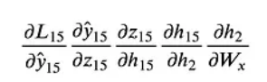
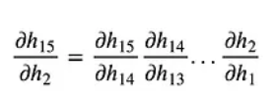
Problems with RNN
Vanishing/Exploding Gradient Problem
However, the word “brown” is quite far from the word “shepherd.” From the gradient calculation of Wx, we can break down the backpropagation error of the word “shepherd” back to “brown” and see what it looks like: which itself has:
These chains of gradients are troublesome because if less than 1 they can cause the loss from the word shepherd with respect to the word brown to approach 0, thereby vanishing.
For eg, 0.5²⁰ = 0.00000095…, and 1.5²⁰ = 3325.25…
This makes it difficult for the weights to take into account words that occur at the start of a long sequence.
So the word “brown” when doing a forward propagation, may not have any effect in the prediction of “shepherd” because the weights weren’t updated due to the vanishing gradient.

Slide 21
Problems with RNN
Difficulty In Capturing Long-Term Dependencies
Although RNNs are designed to capture information about past inputs, they can struggle to capture long-term dependencies in the input sequence. This is because the gradients can become very small as they propagate through time, which can cause the network to forget important information.
Lack Of Parallelism
RNNs are inherently sequential, which makes it difficult to parallelize the computation. This can limit the speed and scalability of the network.
Difficulty In Choosing The Right Architecture
There are many different variants of RNNs, each with its own advantages and disadvantages. Choosing the right architecture for a given task can be challenging, and may require extensive experimentation and tuning.
Difficulty In Interpreting The Output
The output of an RNN can be difficult to interpret, especially when dealing with complex inputs such as natural language or audio. This can make it difficult to understand how the network is making its predictions.

Slide 22

Problems with RNN

Slide 23
Link to the Colab Notebook

Slide 24
Long Short Term Memory (LSTM)

Slide 25

Introduction
Consider this e.g. of Sentiment Analysis

Slide 26
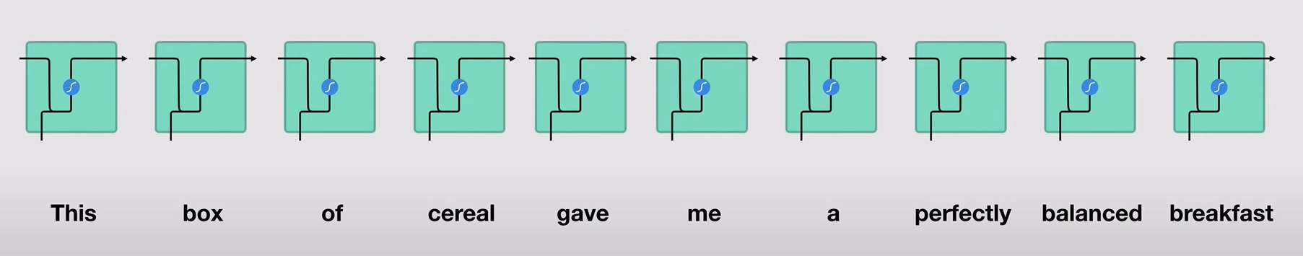
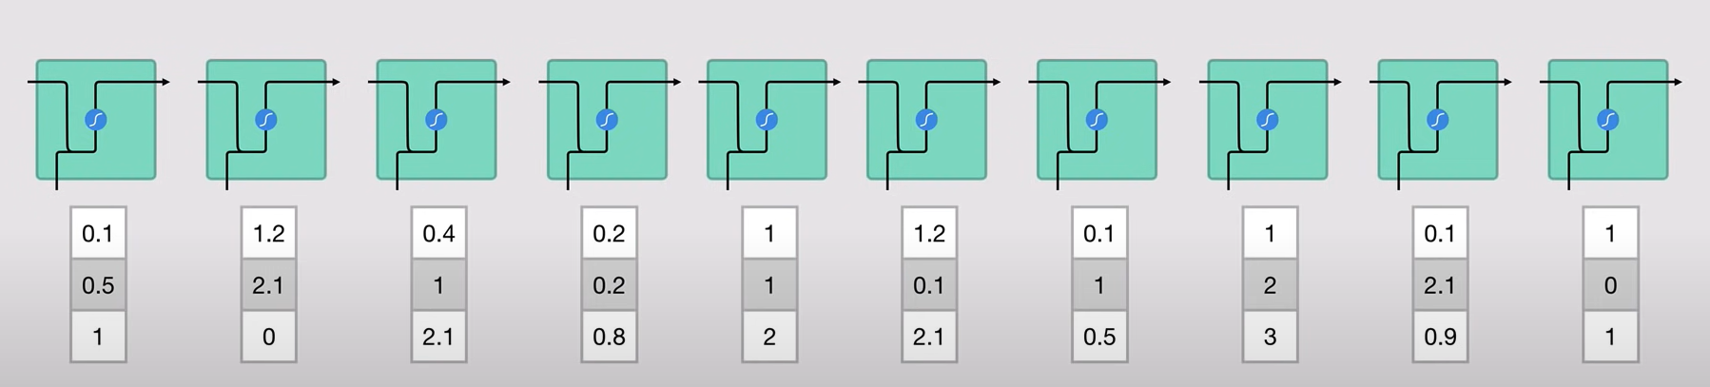
Introduction

Slide 27
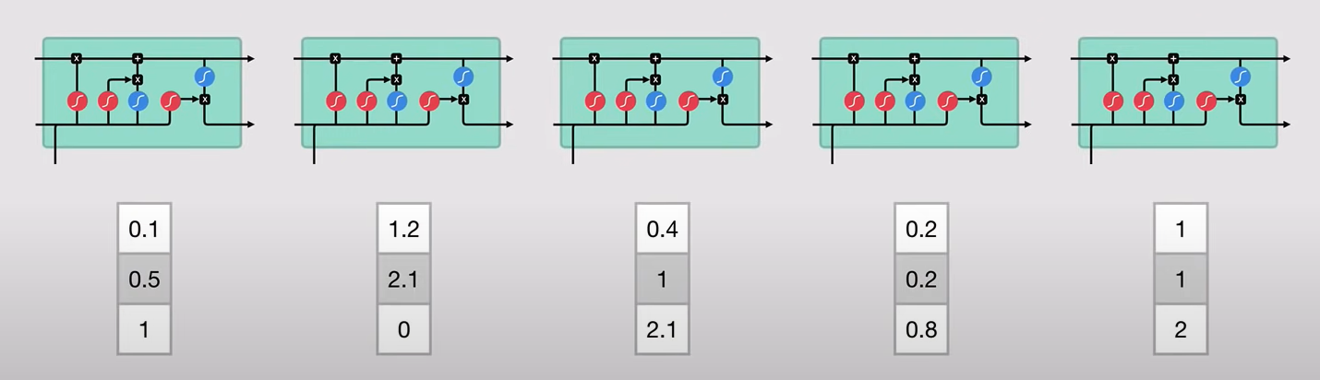
LSTM Architecture

Slide 28
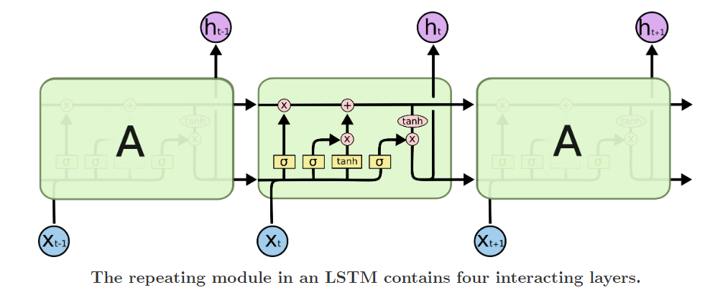
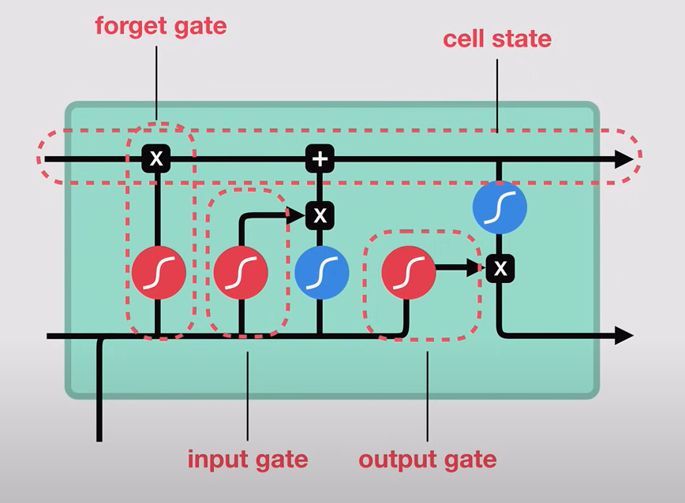
Repeating Unit

Slide 29
How do LSTMs Work
The output of an LSTM at a particular point in time is dependent on three things:
The current long-term memory of the network — known as the cell state
The output at the previous point in time — known as the previous hidden state
The input data at the current time step

Slide 30
Gates in LSTM
LSTMs use a series of ‘gates’ which control how the information in a sequence of data comes into, is stored in and leaves the network.
There are three gates in a typical LSTM; forget gate, input gate and output gate.
These gates can be thought of as filters and are each their own neural network.

Slide 31
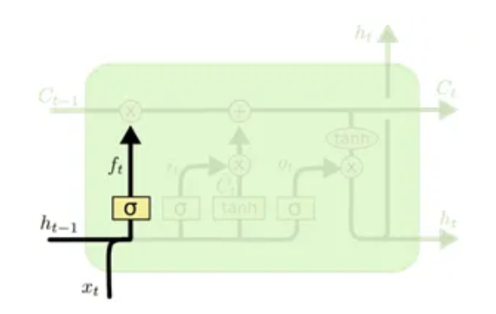
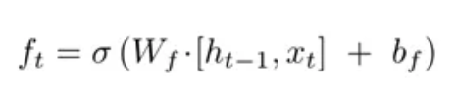
Forget Gate
To learn new information, you need to forget older irrelevant information. Forget Gate does that.
Sigmoid Activation function: Return a number between 0 and 1.
Multipy it with a percentage of older information to remember.
Multiplication with 0 means no long term information is remembered.
Multiplication with 1 means long term information is entirely preserved

Slide 32
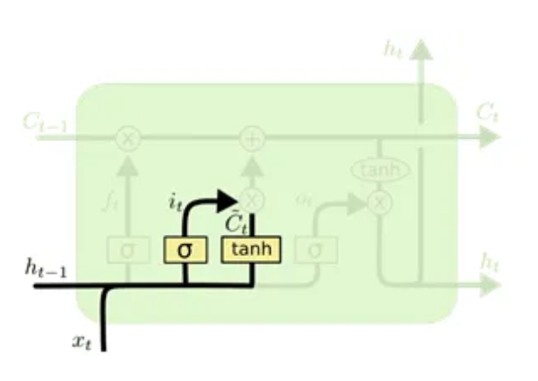
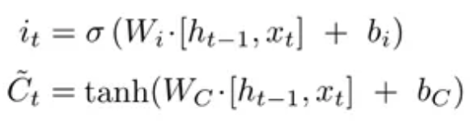
Learn Gate
To learn new information, you need to add new information to memory
There are 2 parts here,
Generate new information using tanh activation (value between -1,1)
Decide Percentage of new information to learn using sigmoid activation (value between 0,1)
We use Tanh activation function for new information because it will output vectors (in range -1 to 1) which are centered around 0.
This will distribute the gradients very well and allow the cell states to run longer. This eventually will solve the vanishing or exploding gradients problem.

Slide 33
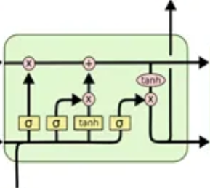

Remember Gate
Addition of output from forget gate and learn gate

Slide 34
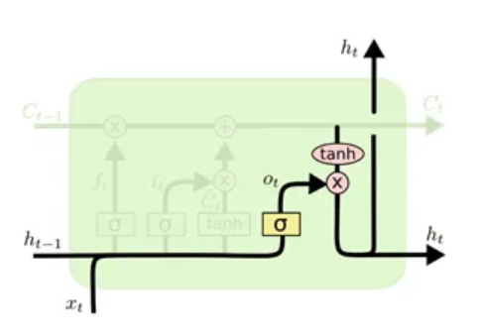
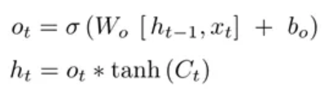
Output Gate
This is done to modify the hidden state
The output is a filtered version of the cell state.
The cell state value from the remember gate is multiplied with a tanh activation function.
The output from tanh will be between -1 and 1. We then multiply the output through a sigmoid function again, to forget some of the values.
The resulting value will be the hidden state for the next time instance (h_{t}).

Slide 35
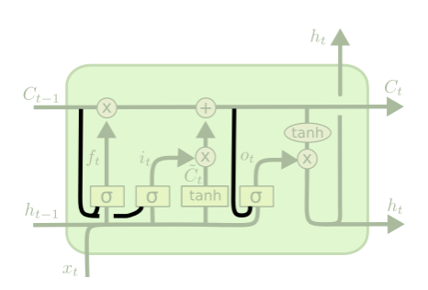
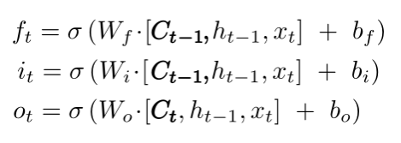
Variants of LSTMs
Peephole LSTMs
Here the gate layers look at the cell state.
This particular diagram adds peepholes to all the gates
You can have Peephole LSTMs with fewer peepholes

Slide 36
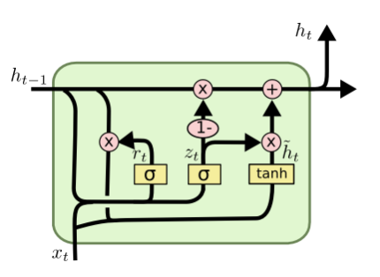
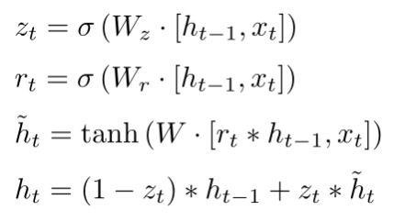
Variants of LSTMs
Gated Recurrent Unit (GRU)
It combines the forget and input gates into a single “update gate.”
It also merges the cell state and hidden state, and makes some other changes.
The resulting model is simpler than standard LSTM models, and has been growing increasingly popular.

Slide 37
Drawbacks of LSTMs
Longer training times
Large memory requirements
Unable to parallel training

Slide 38
Conclusion
We have learned that Recurrent Neural Networks (RNNs) and Long Short-Term Memory (LSTM) networks are powerful tools for working with sequence data, such as natural language text and time series data.
LSTMs, in particular, have been a significant milestone in the field of NLP and sequence models, with the ability to handle long-term dependencies and generate high-quality output.
However, like all models, LSTMs have their limitations, including long training times, large memory requirements, and the inability to parallelize training.
To address these challenges, new and improved models and techniques, such as Attention, have been developed.

Slide 39
Link to the Colab Notebook

Slide 40
Thank You

Slide 41
References
The Basics of Recurrent Neural Networks (RNNs) | by Ben Khuong | Towards AI
Illustrated Guide to Recurrent Neural Networks: Understanding the Intuition – YouTube
Recurrent Neural Network (RNN) Tutorial: Types and Examples [Updated] | Simplilearn
Long Short-Term Memory Networks. Introduction | by Vinithavn | Analytics Vidhya | Medium
Understanding LSTM Networks -- colah's blog
LSTM Networks | A Detailed Explanation | Towards Data Science
Illustrated Guide to LSTM's and GRU's: A step by step explanation – YouTube
Long Short-Term Memory Networks. Introduction | by Vinithavn | Analytics Vidhya | Medium

